Slide 1
Chemistry Notes: The Periodic Table

Slide 2
Every element has its own unique symbol.
For some elements the symbol is simply the first letter of the element’s name.
Examples: Hydrogen = H, Sulfur = S, Carbon = C
Symbols for other elements use the first letter plus one other letter of the element’s name. The first letter is CAPITALIZED and the second letter is not.
Examples: Aluminum = Al, Platinum = Pt, cadmium = Cd
The origins of some symbols are not as obvious. Some elements have symbols that refer to the element’s name in latin.
Examples: gold = Au, lead = Pb, copper = Cu

Slide 3
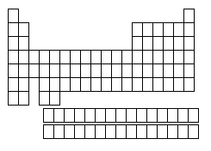
The Periodic Table
Column (up and down)= Group or Family
18 columns on the Periodic Table
Row (side to side)= Period
7 rows on the Periodic Table

Slide 4
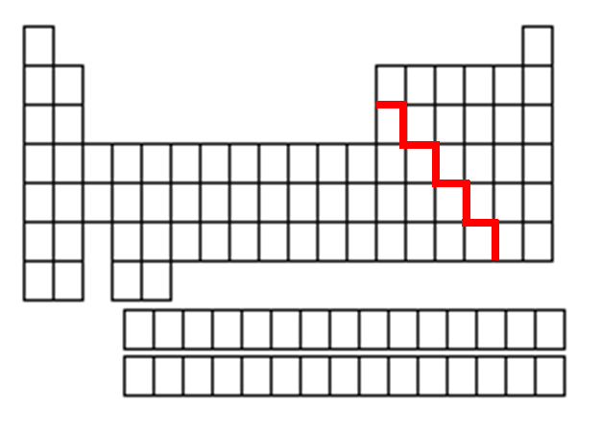
Metals, Nonmetals, and Metalloids
Only
nonmetal on the metal side
Nonmetals are on the right of the stair-step
Metals are to the left of the stair- step
Metalloids touch the stair-step

Slide 5
Valence Electrons and Reactivity
Valence electrons are the electrons farthest from the nucleus. Atoms have different numbers of valence electrons.
Reactivity: how likely an atom is to interact (react) with other atoms. Some elements are very reactive, while others almost never react.

Slide 6
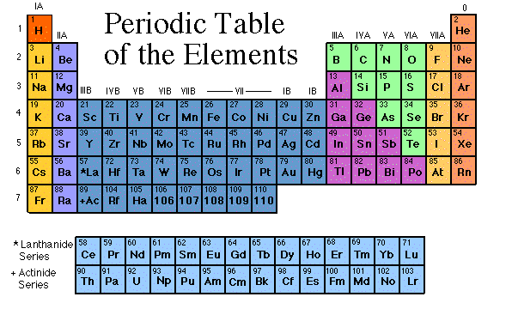
The Groups/Families of the Periodic Table
Elements on the periodic table can be grouped into families (or groups) based on their chemical properties.
We call them “families” because the elements in each family are “related.”
Each family has a specific name to differentiate it from the other families in the periodic table.
Elements in each family
react differently with
other elements.

Slide 7
Family Flip Cards for Element
On a series of paper slips, create a book section for each of the following groups/families (column) of elements.
Section must include:
the provided notes
at least some of the elements listed as examples
List chemical properties/reactivity that family share. (see group 1 for example).

Slide 8
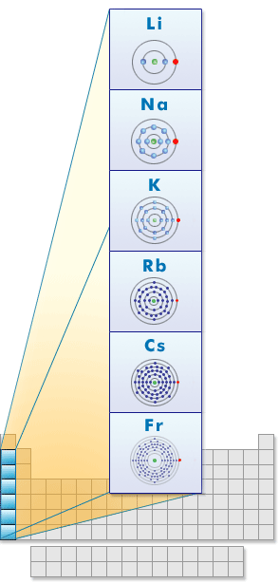
Group 1: the Alkali Metals (Color Li through Fr Red)
Hydrogen is NOT part of this family!!!
Most reactive metals
Rarely found free (by themselves) in nature
Form ions with a charge of +1, have 1 valence electron
Soft and silvery, shiny
Very reactive, esp. with water

Slide 9
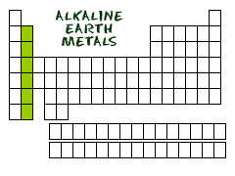
Group 2: the Alkaline Earth Metals (Color Orange)
Still quite reactive group of metals
Form ions with a charge of +2, have 2 valence electrons
White, silvery, and malleable
Conduct electricity

Slide 10
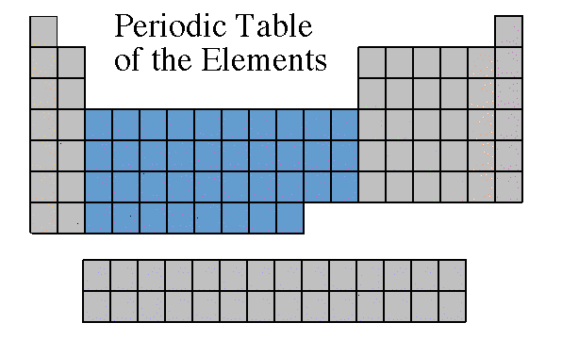
Groups 3-12: Transition Metals (Color Blue)
Found freely and in compounds in nature
Form ions with a charge of usually +2 but can vary—usually 2 valence electrons
Almost all are solids at room temp (except Mercury, Hg, is a liquid)
Good conductors of heat
and electricity.

Slide 11
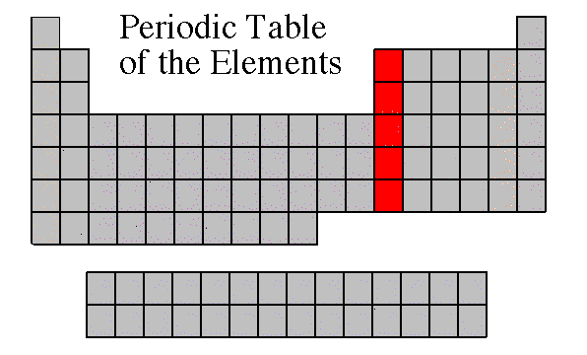
Group 13: Boron Family (Color Metalloids yellow and metals blue)
A mixed group of metalloids and metals
Found freely and in compounds in nature
Form ions with a charge of +3, have 3 valence electrons

Slide 12
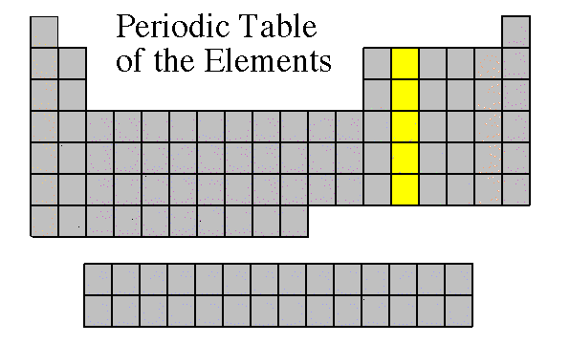
Group 14: The Carbon Family (Color Nonmetals green, Metalloids yellow and metals blue)
A mixed group of element types
Contains elements that can form unusual bonds (carbon and silicon), forming many different compounds (all organic compounds have C in them).
Form ions with a charge of +4 or -4, have 4 valence electrons

Slide 13
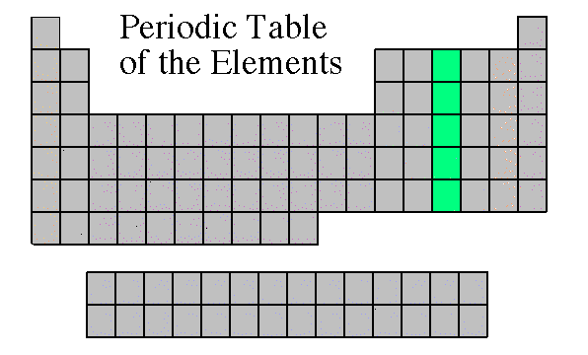
Group 15: the Nitrogen Family (Color Nonmetals green, Metalloids yellow and metals blue)
A mixed group of element types
Form ions with a charge of -3, have 5 valence electrons

Slide 14
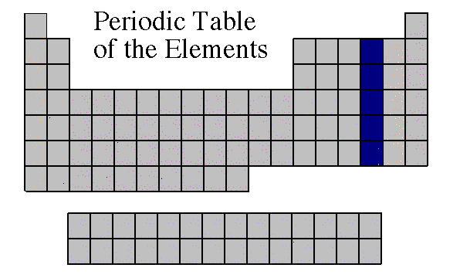
Group 16: The Oxygen Family (Color Nonmetals green, Metalloids yellow and metals blue)
A mixed group of element types
Also known as the chalcogens
Form ions with a charge of -2, have 6 valence electrons

Slide 15
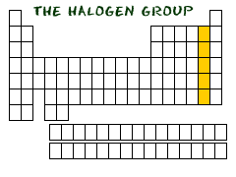
Group 17: the Halogens (Outline in Brown)
Most reactive nonmetals
Rarely found free (by themselves) in nature
Form ions with a charge of -1, have 7 valence electrons

Slide 16
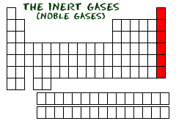
Group 18: The Noble Gases (Inert Gases) (Outline in Purple)
Group of nonmetals
Nonreactive
Do not form ions! Charge is 0, have either 2 or 8 valence electrons
All are gases

Slide 17
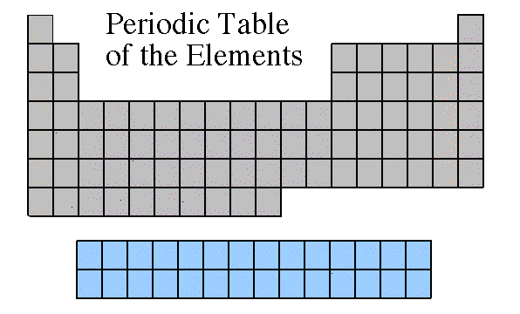
Rare Earth Metals (outline in Pink)
Some are Radioactive
The rare earths are silver, silvery-white, or gray metals.
Conduct electricity
Lanthanides
Actinides

